Slide 1
Interactive Programs
Mr Mack 2021

Slide 2
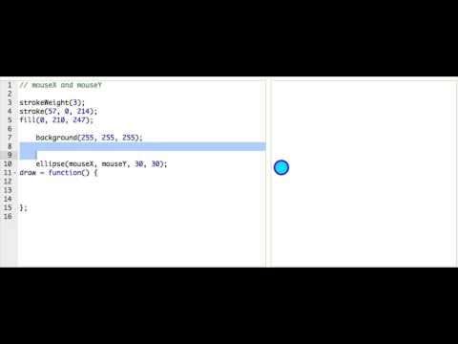
Mouse Interaction

Slide 3

Practice: Tasty Tomato
Before we make this program respond to mouse interaction, let's make a little change. See the bite in the tomato? It's tiny now, make it bigger!
Tip: the bite is being drawn as an ellipse. To make it bigger, you have to replace the width and height of the bite ellipse with numbers greater than 30.
Bigger bite!

Slide 4
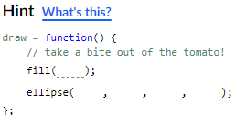
Practice: Tasty Tomato
Right now, there's just one bite in this tomato - but we want to be able to eat it all! We can do that by drawing a new bite everytime the user moves the mouse. The first step is to create a draw() function, and move the bite drawing code into it.
Remember: moving code into a function - or putting it inside a function - means putting the code between the {curly braces} that appear after the function.
Tip: You can select and drag the bite drawing code to easily move it around.
Prepare to eat!

Slide 5
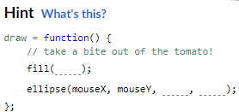
Practice: Tasty Tomato
Now, to make it so that we can make more bites when we move the mouse, you need to change the x and the y coordinates of the bite to be based on mouseX and mouseY instead. To check that it works, just move your mouse!
Eat it!

Slide 6
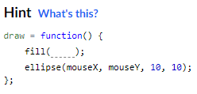
Practice: Mouse Mania
This program paints colorful shapes on the screen wherever the user's mouse moves, and you're going to change it up! First, change the fill() function call so that the circles become a different color. Remember: You can use mouseX and mouseY as parameters to create a variety of colors.
Colorful Colors!

Slide 7
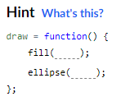
Practice: Mouse Mania
Now change the ellipse() function call somehow. You can make the ellipses a different size, or you can make them change shape by using mouseX and mouseY as parameters.
Shape the Shapes!

Slide 8
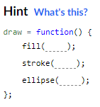
Practice: Mouse Mania
Now, add a stroke color to the ellipses. Remove the noStroke() call and call stroke() inside the draw function.
Outline the Outlines!

Slide 9
Be a Better Coder!

Slide 10
Ask for help
Programming on your own is fun, but sooner or later you’ll get stuck on a problem. Trust me, I've been coding for 20 years and still get stuck sometimes.
So what do you do when you can't find the answer after re-watching talk-throughs and reading through the documentation? After you've spent a while searching for answers in the usual places, that's a fine time to ask for help from your local friendly community

Slide 11
Comments
Add comments to your code to describe what the different parts of your program are meant to do.
// mouth:
fill(87, 24, 24);
ellipse(hopperX + 55, 272, 31, 30);
// glasses:
ellipse(hopperX + 29, 242, 30, 30);
ellipse(hopperX + 80, 242, 30, 30);
arc(hopperX + 55, 242, 20, 16, 180, 360);

Slide 12
Descriptive Variables
Make your code easier to read by using descriptive variable names and white space between parts of your code.
var hopperX = 280;
var mouthX = hopperX - 20;
image(getImage("creatures/Hopper-Happy"), hopperX, 205);
ellipse(mouthX, 272, 31, 30);

Slide 13
When asking for help!
Start the request by describing the issue.
"I want Hopper's glasses to be transparent, so her eyes still show underneath them, but I don't want them completely transparent. How can I make the glasses look tinted?"
Be specific, referring to code lines and their corresponding functions when you can.
"The fill command in line 7 does not affect the arc command in line 11. Why is that, and how can I fix it?”
Notes:
The more effort you put into your help request, the more likely others will be willing to help!
When you do get a response, remember that the best answers are the ones which puts you on the right track, not the ones that do all the work for you.
And finally, as you learn more, don’t forget to check out the help requests to see if you can contribute on the answering side! Even if you don’t know how to solve the problem, you can always learn from the answers that others are giving.

